Slide 1





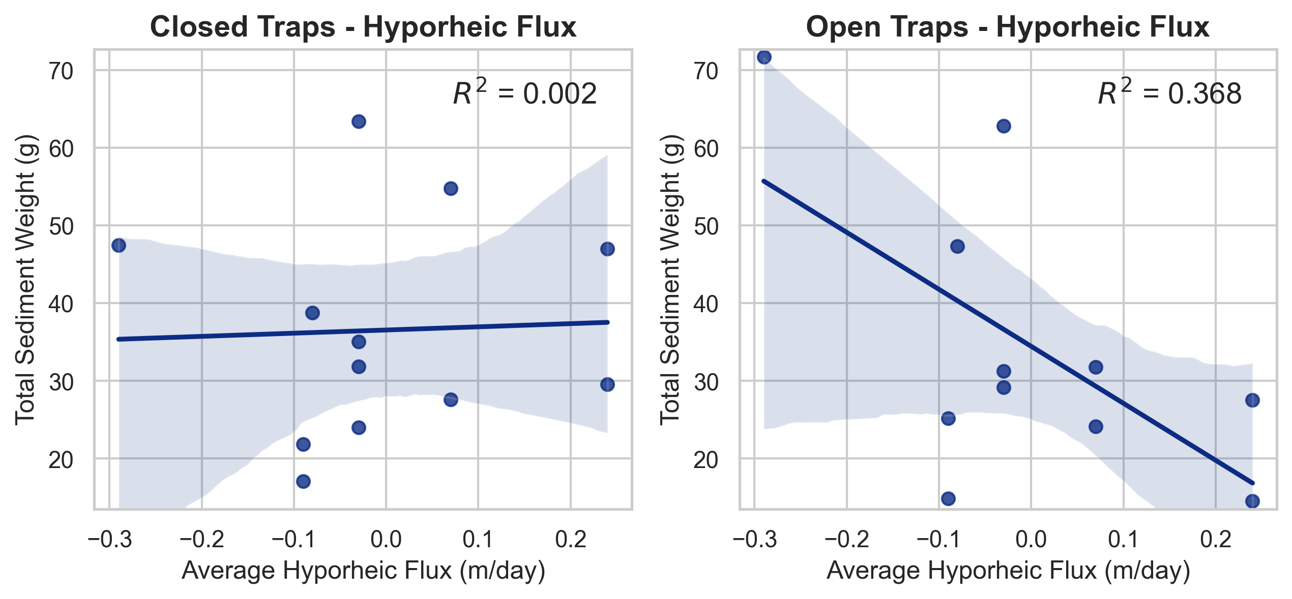
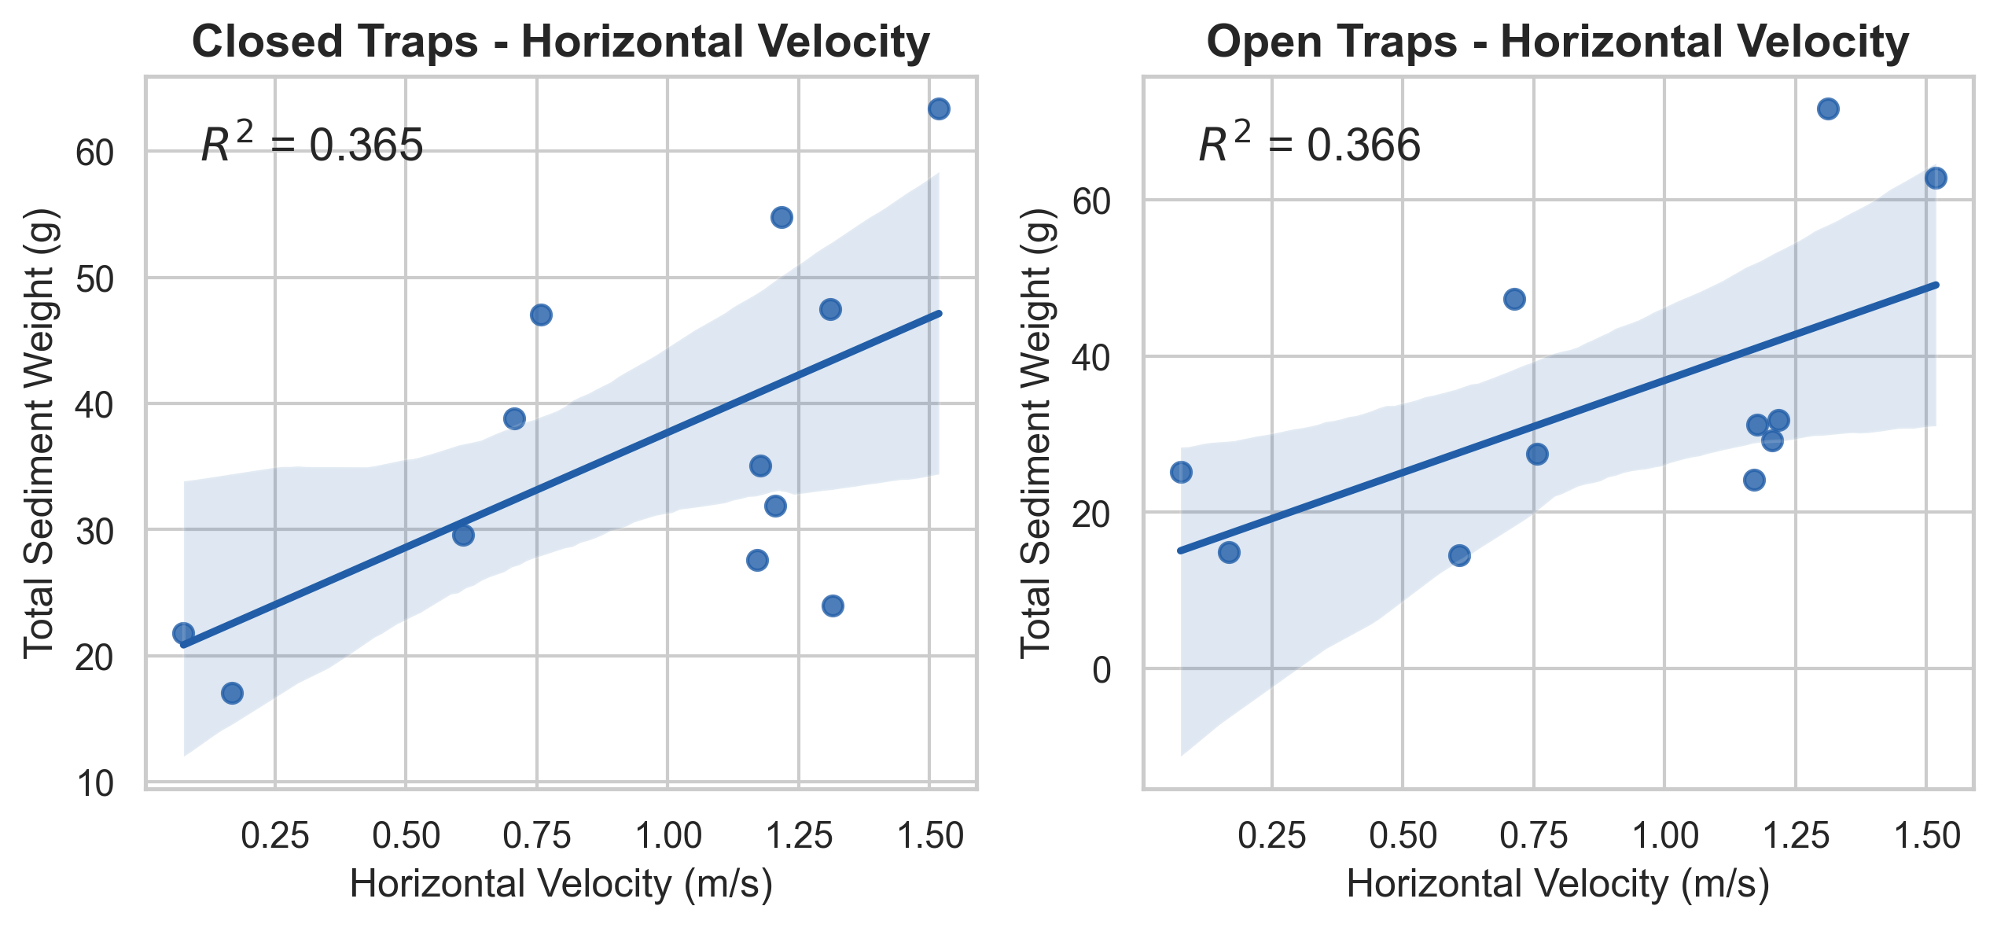
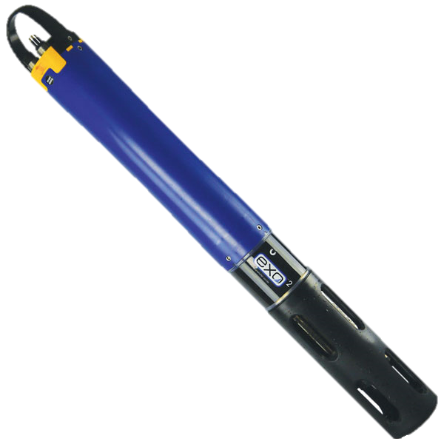
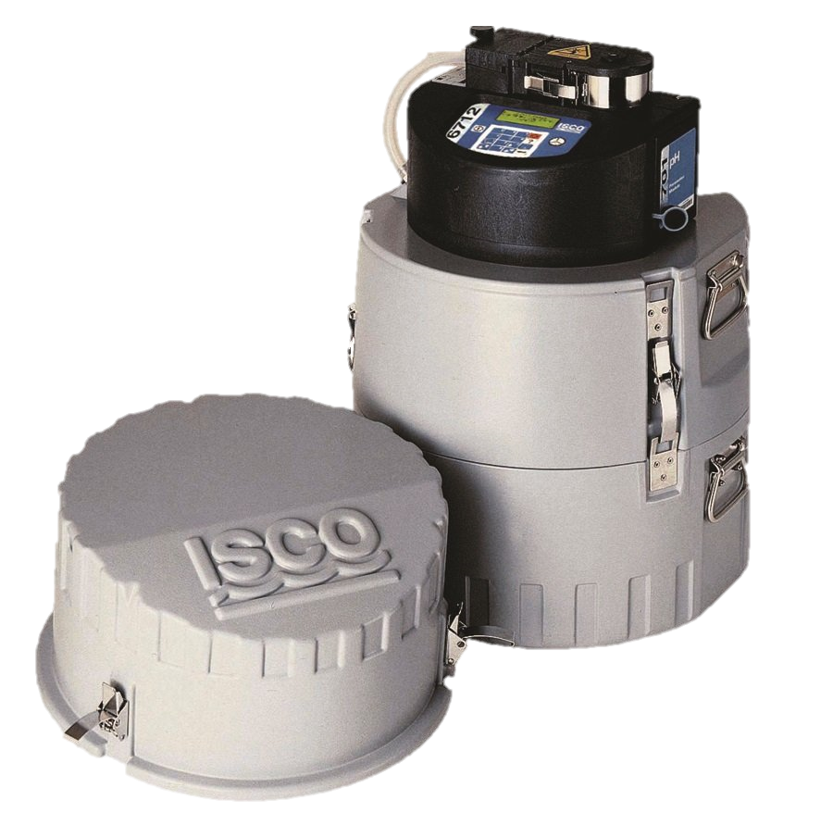
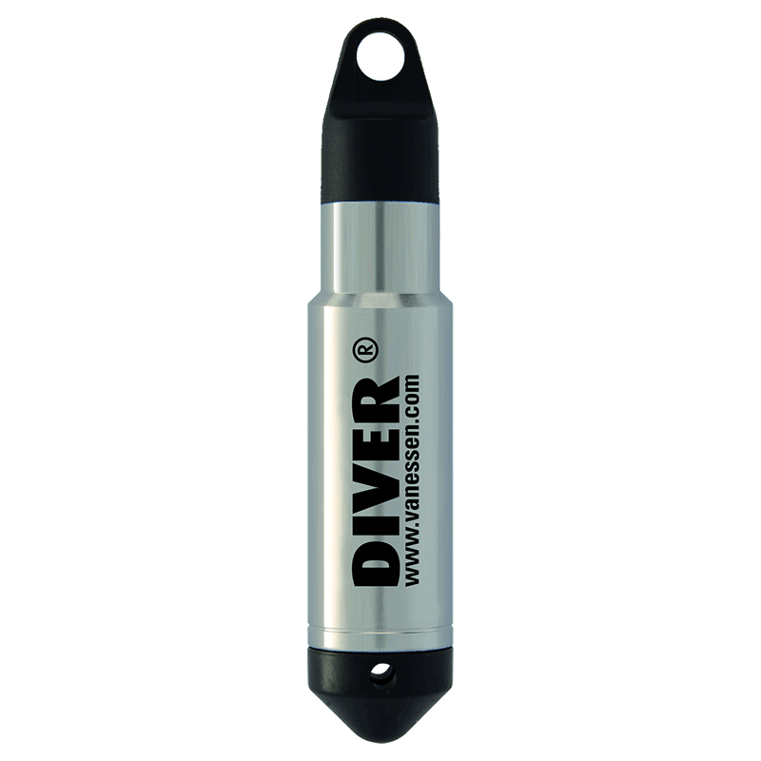
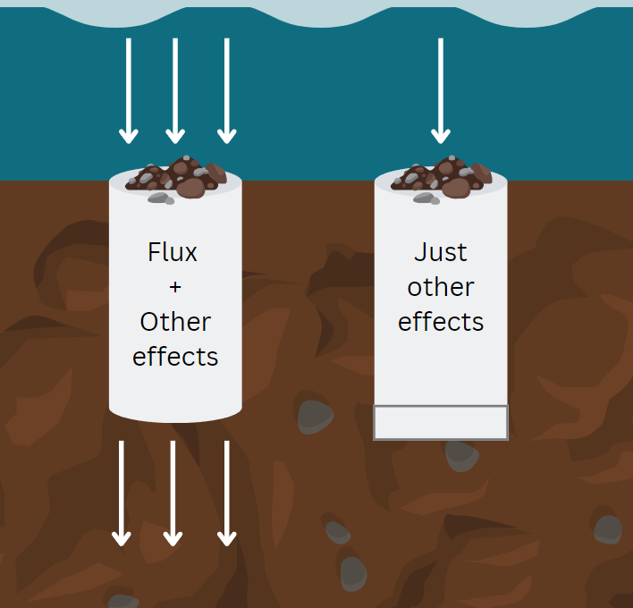
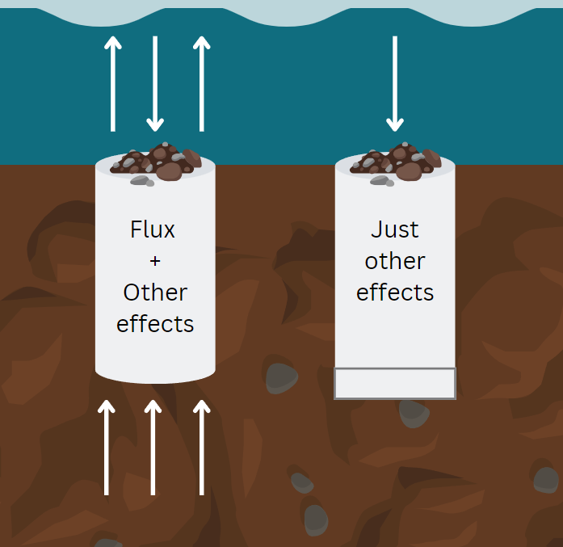
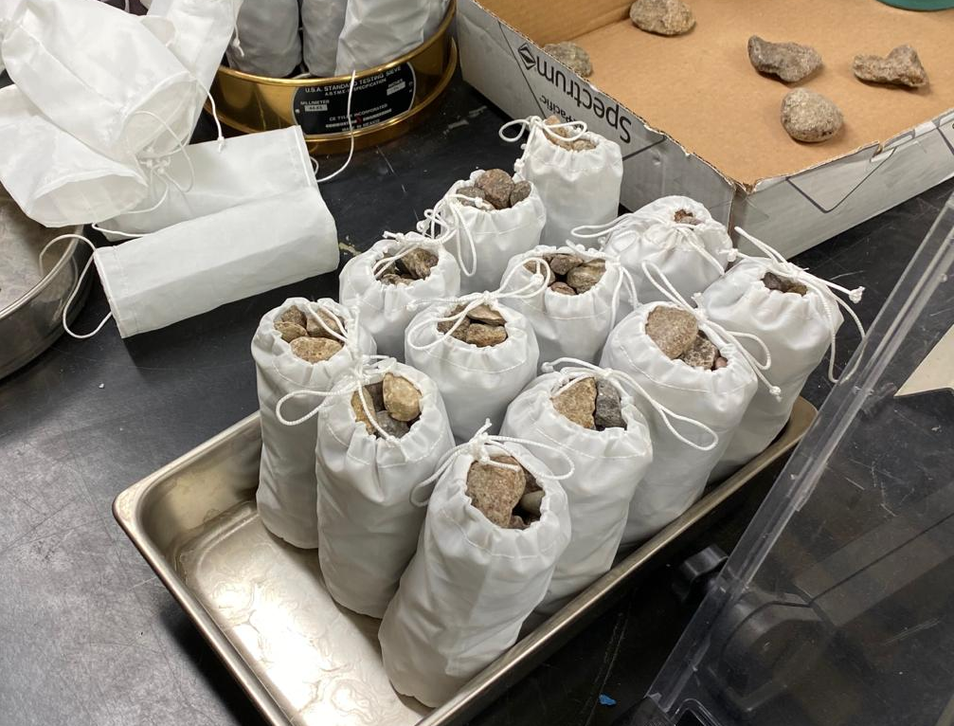
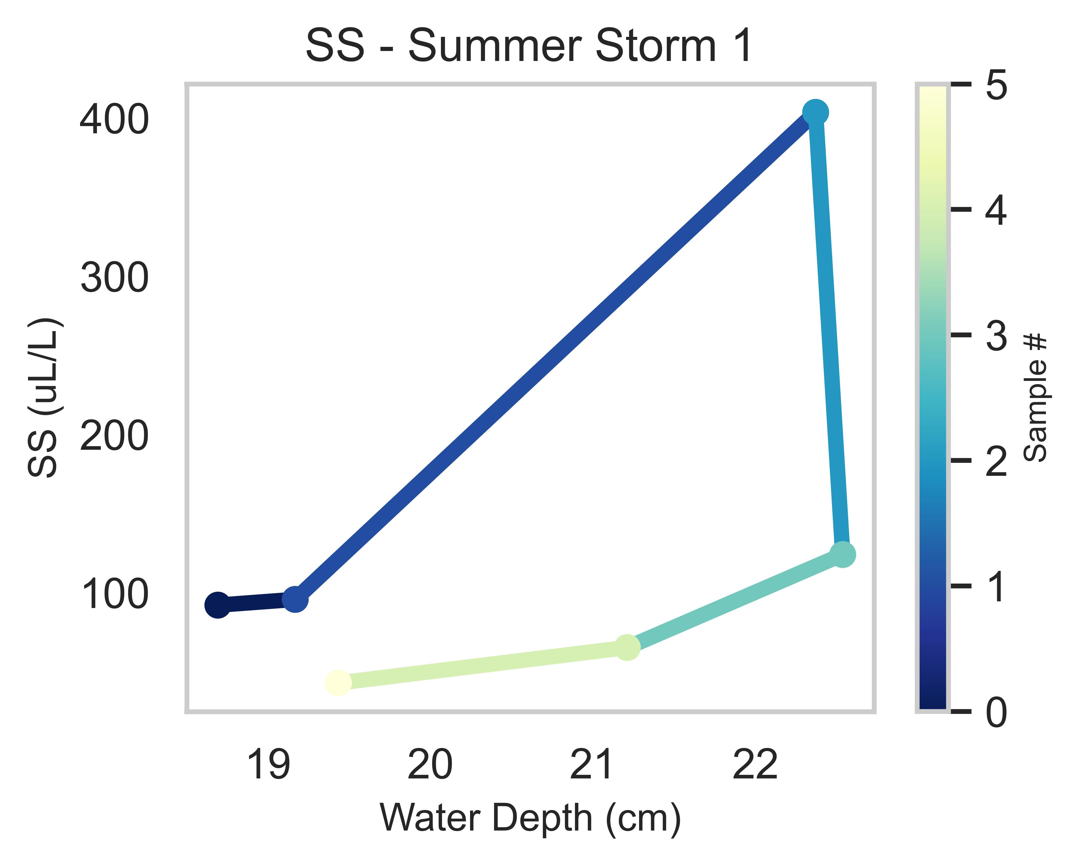
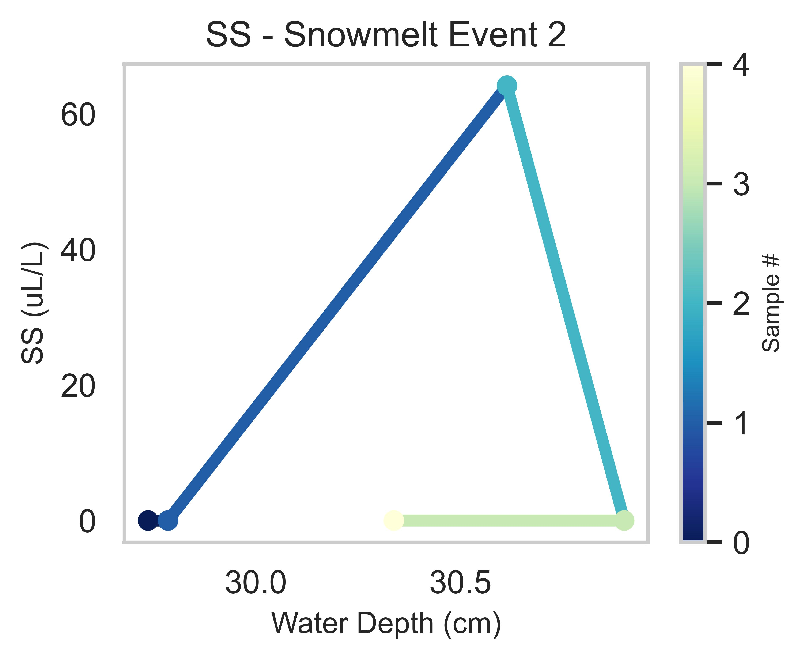
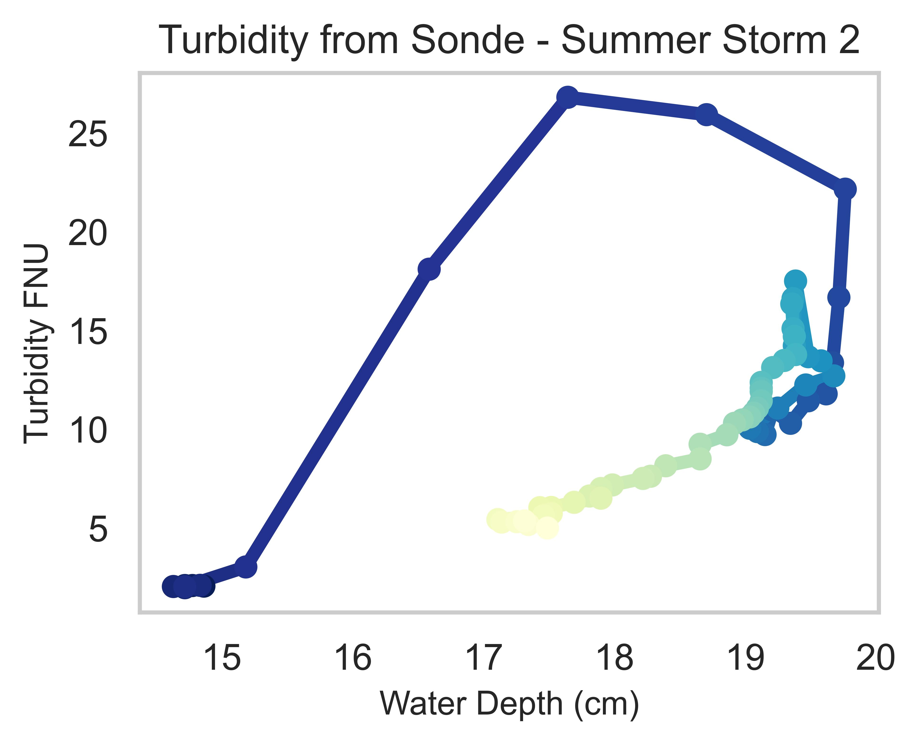
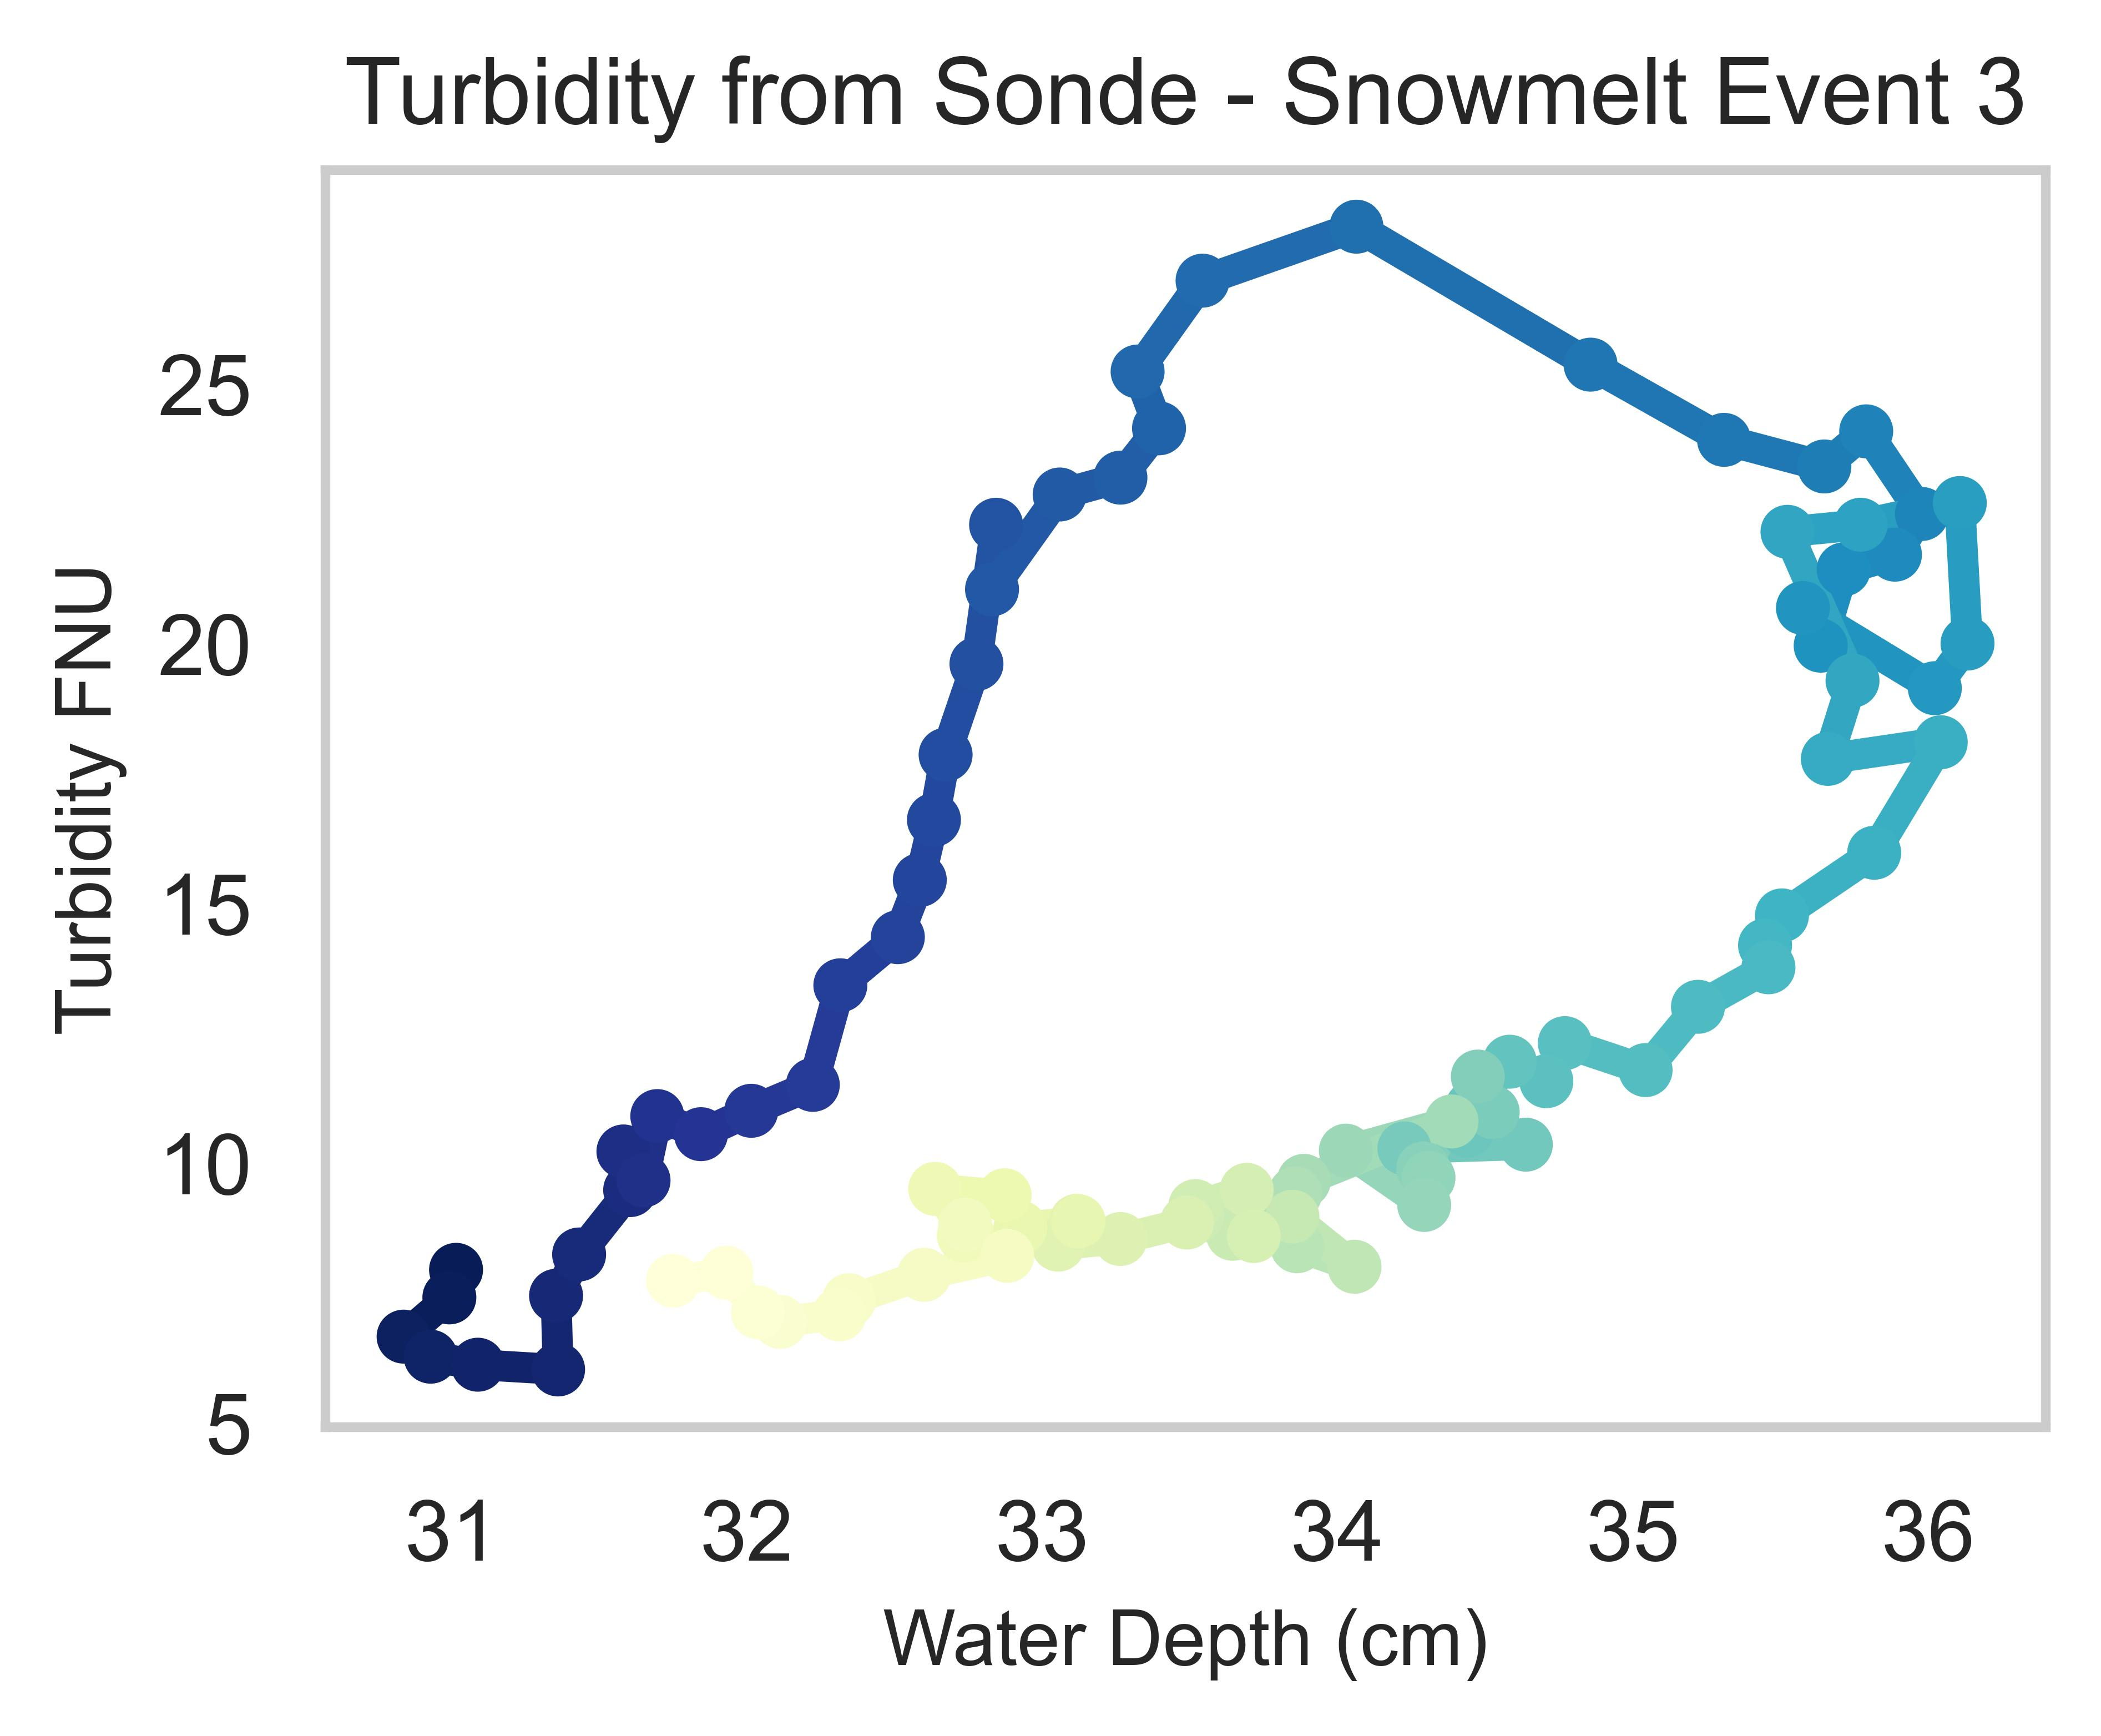
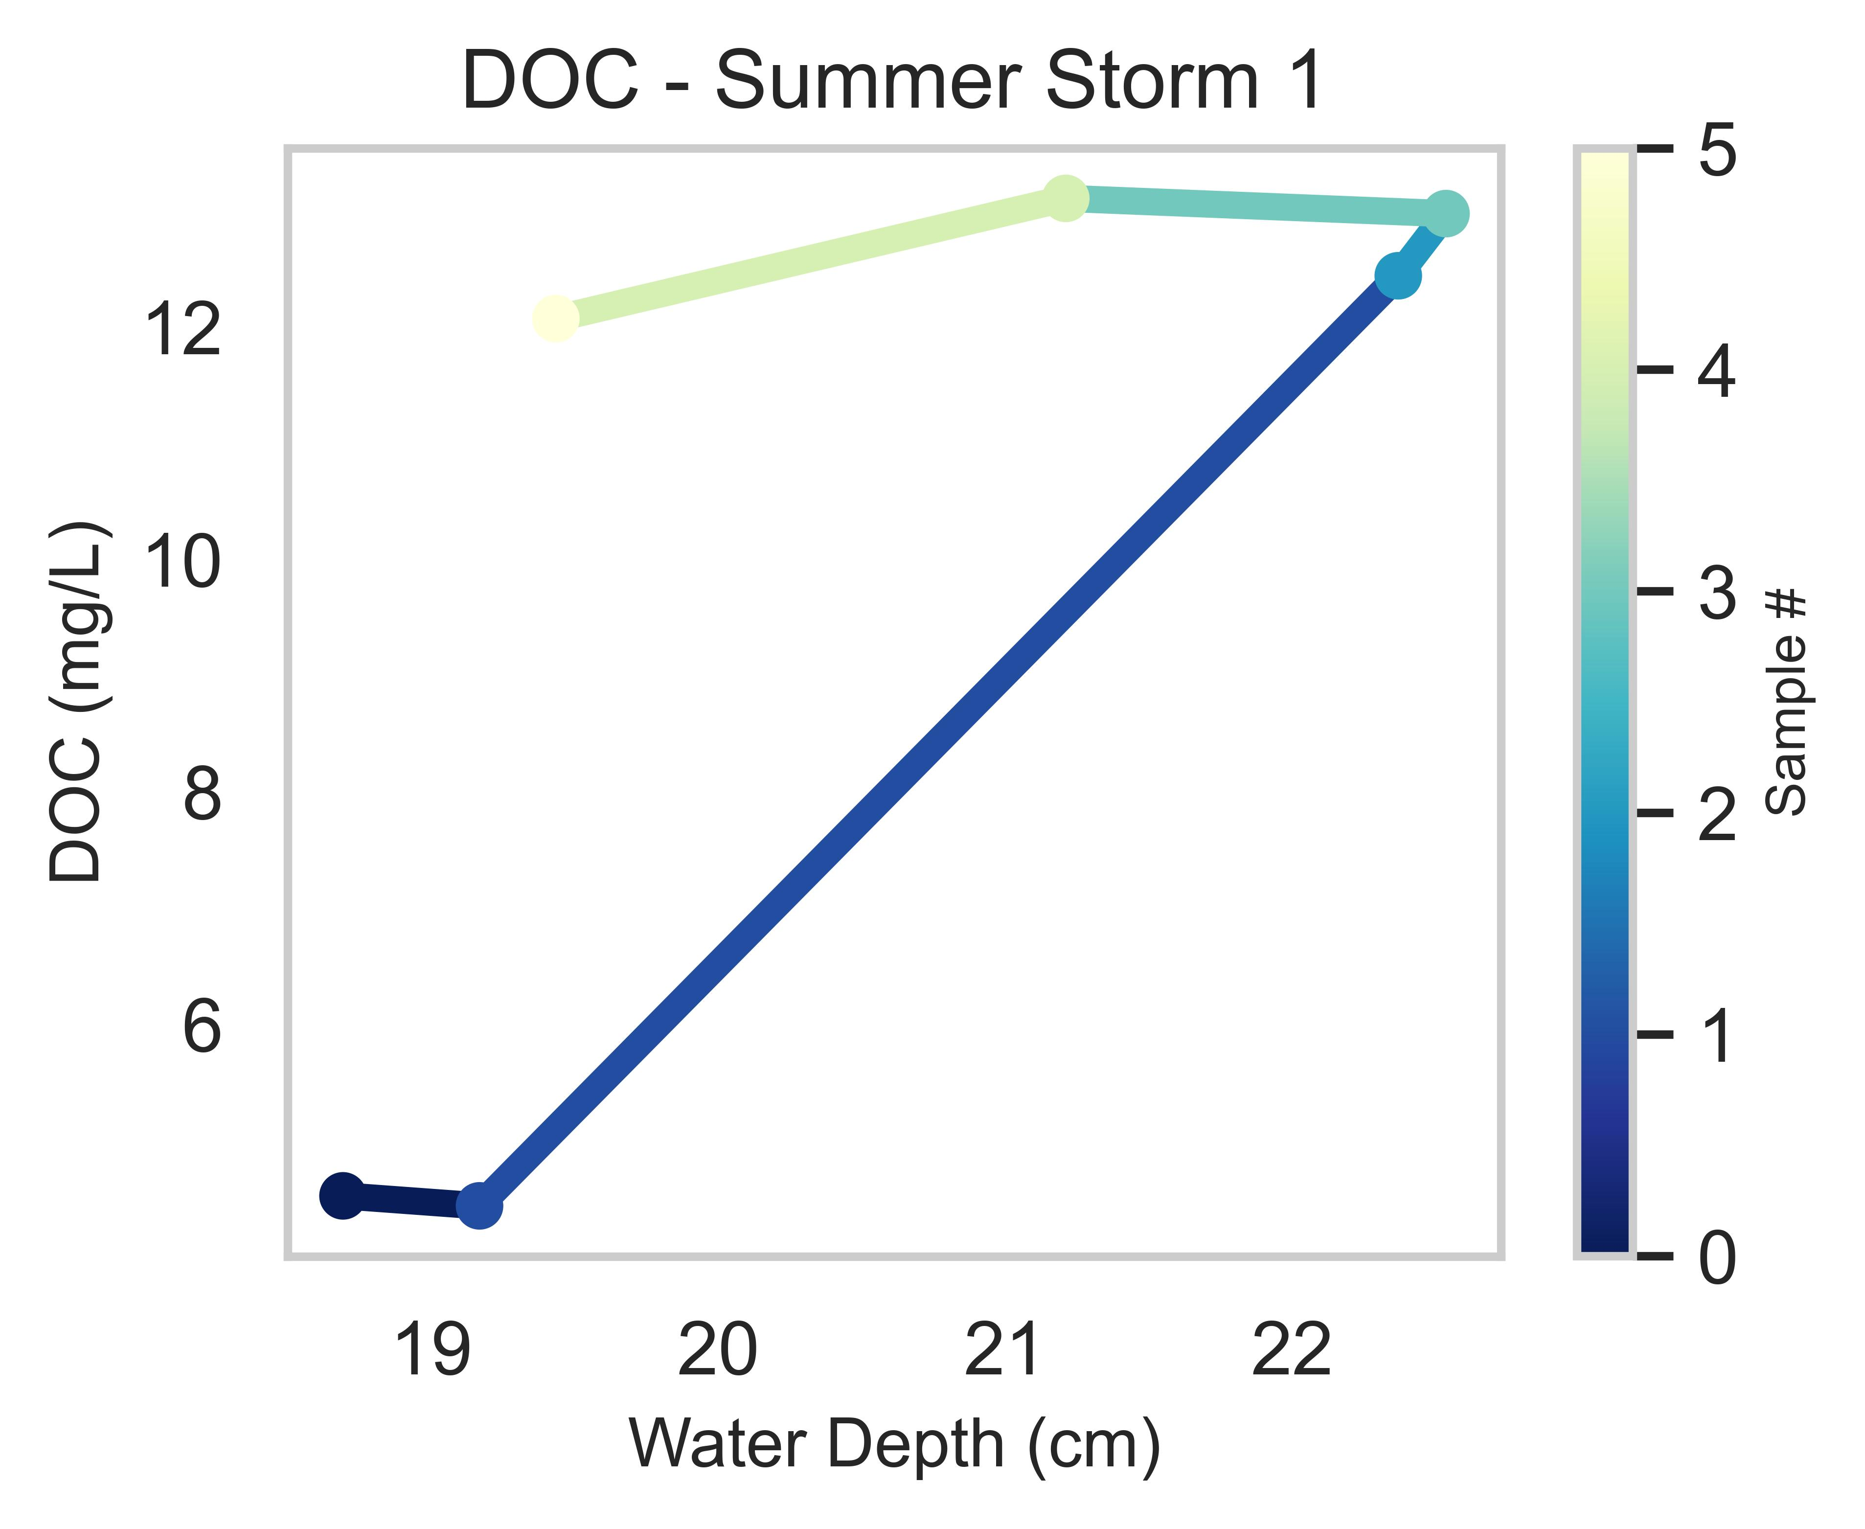
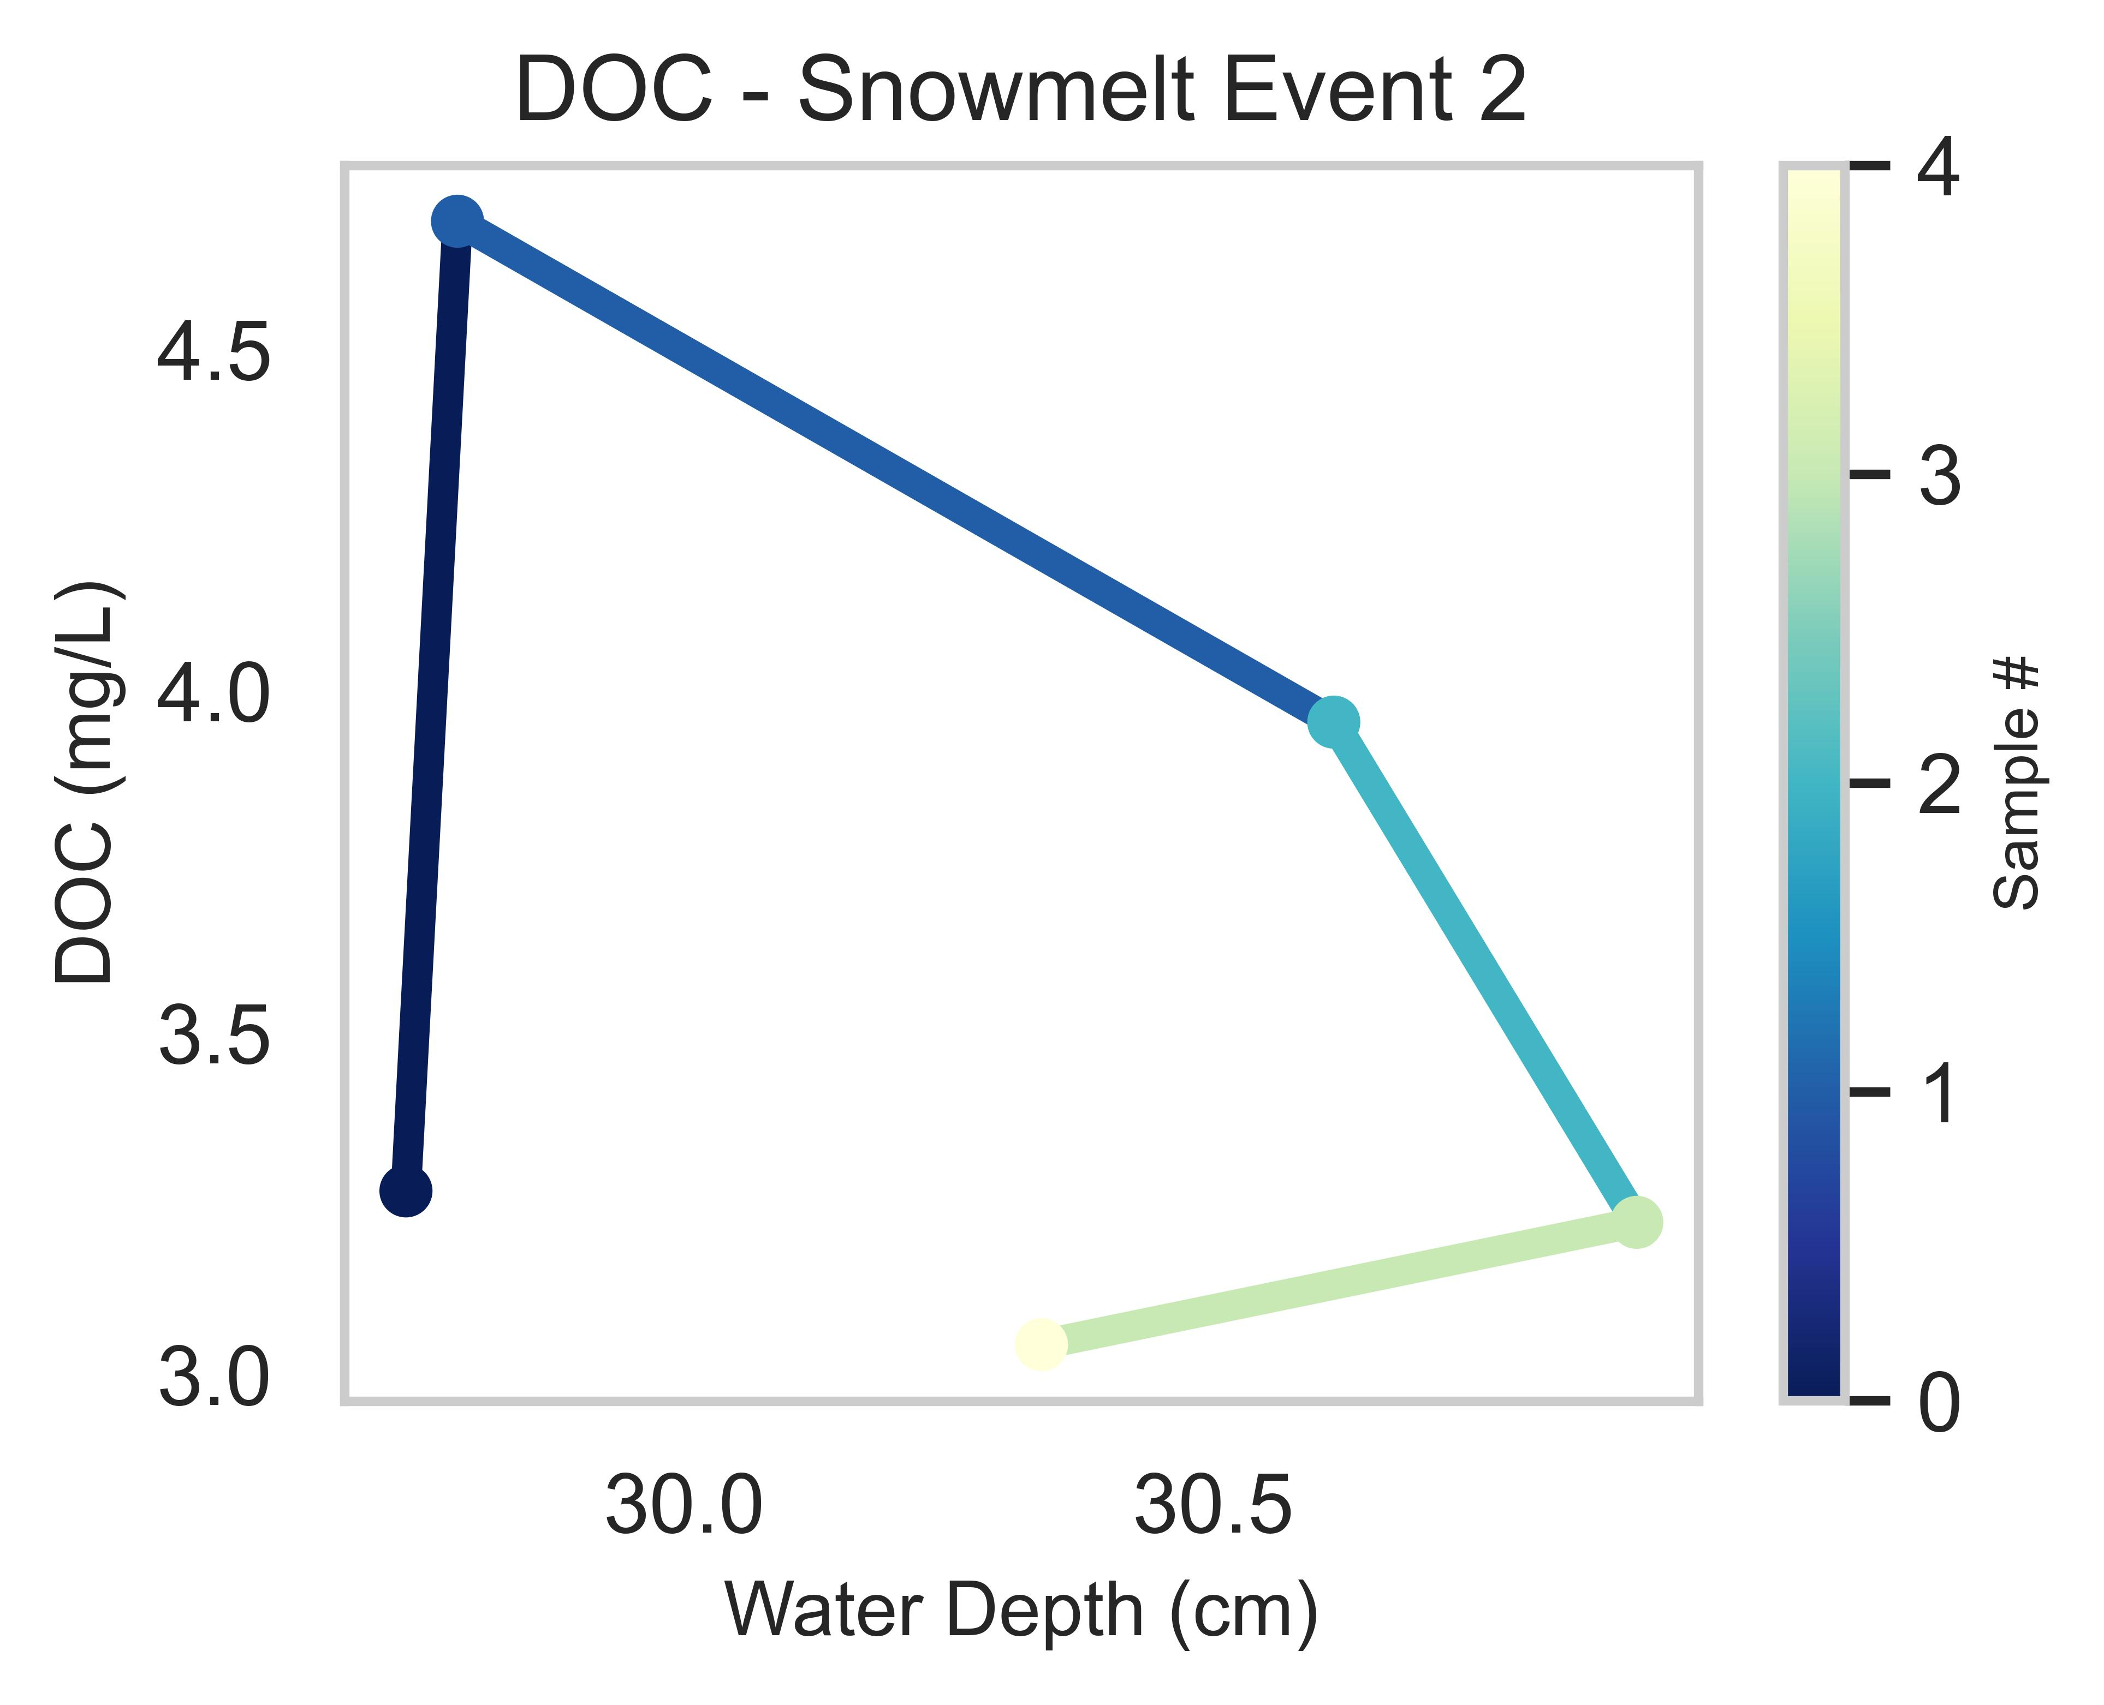
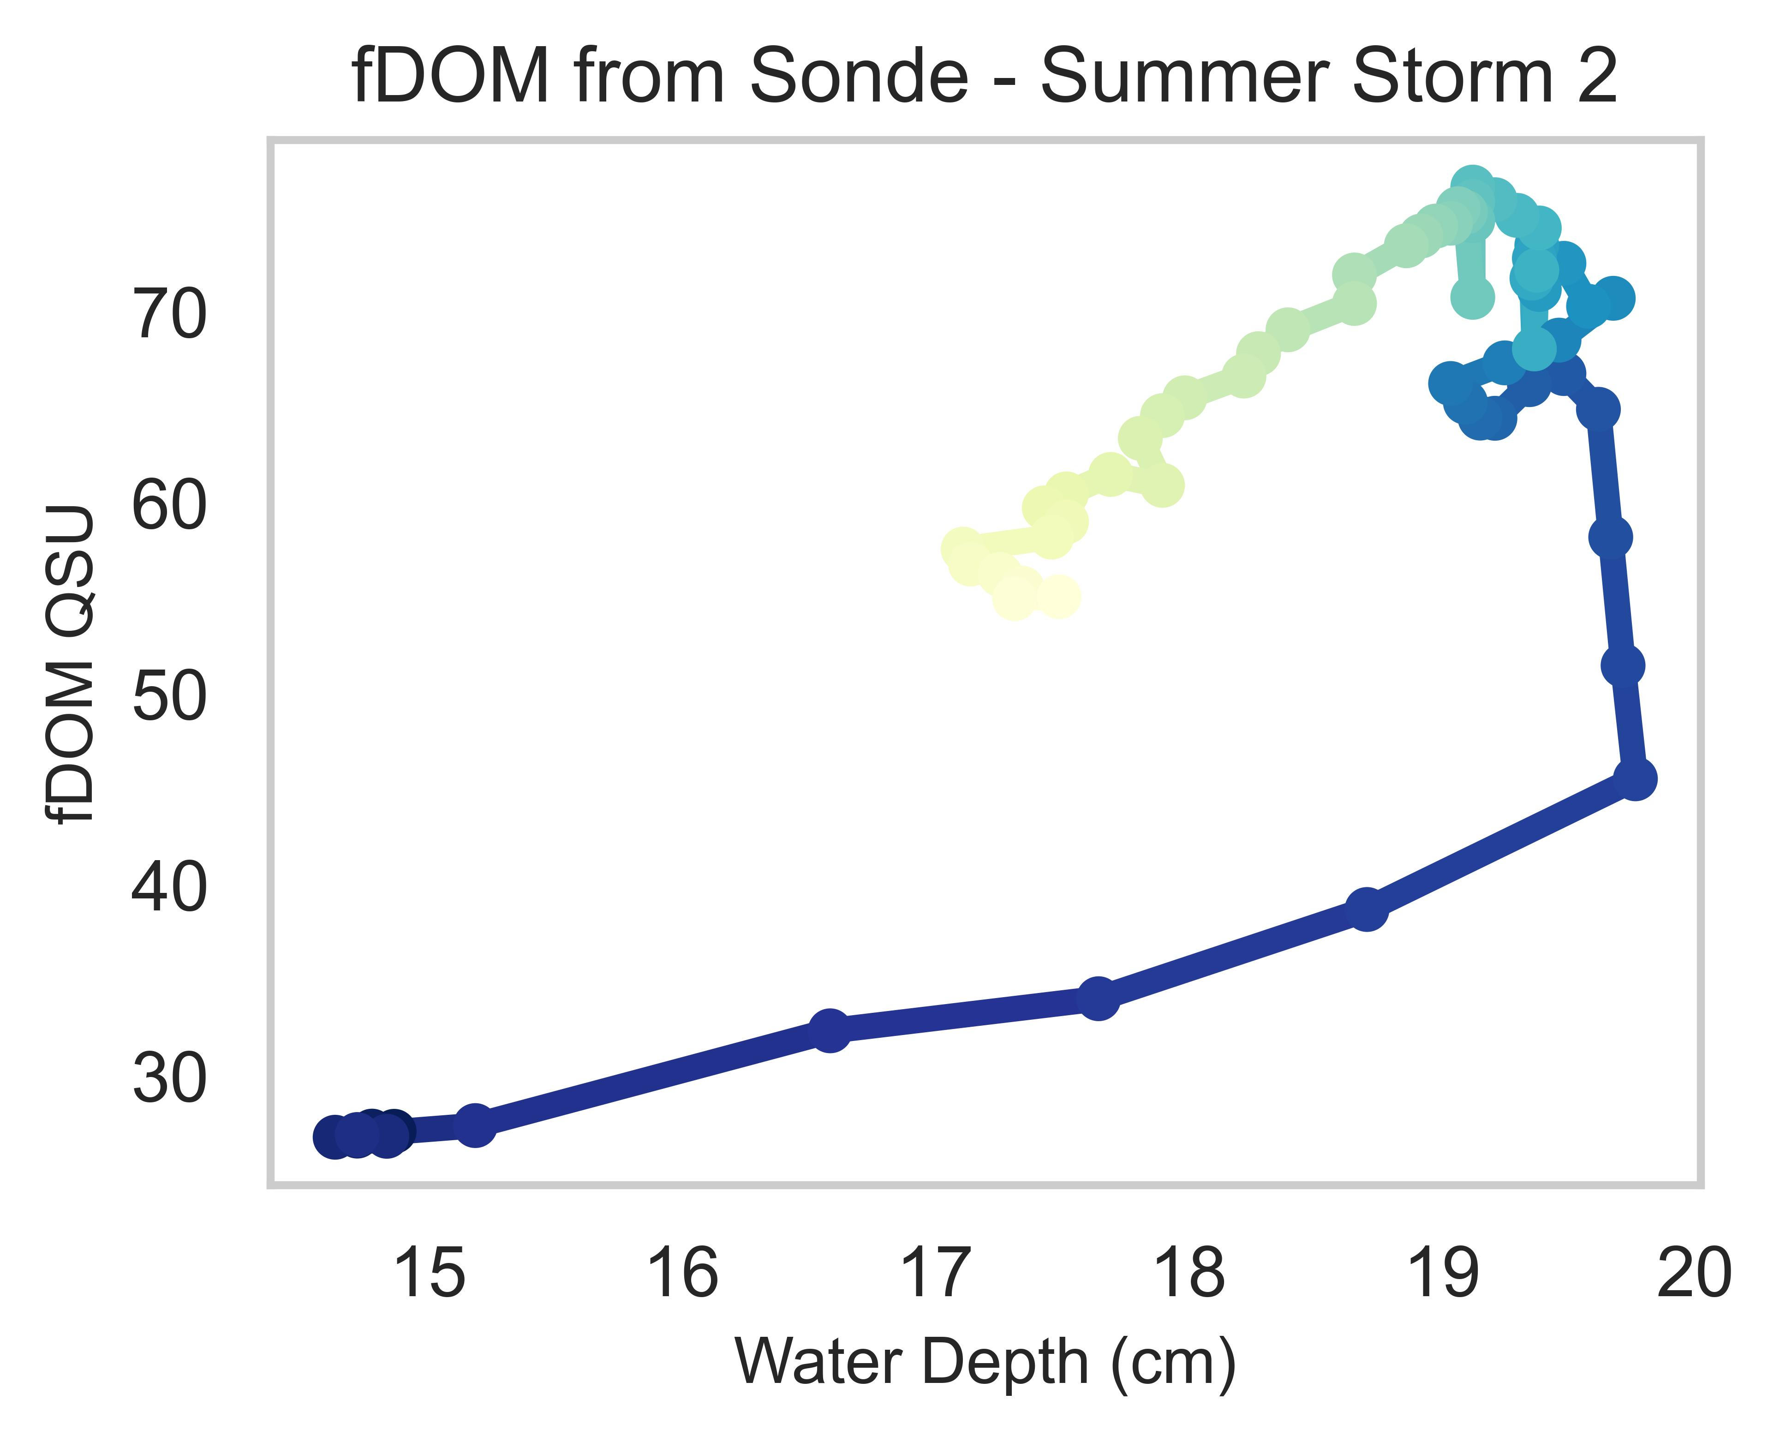
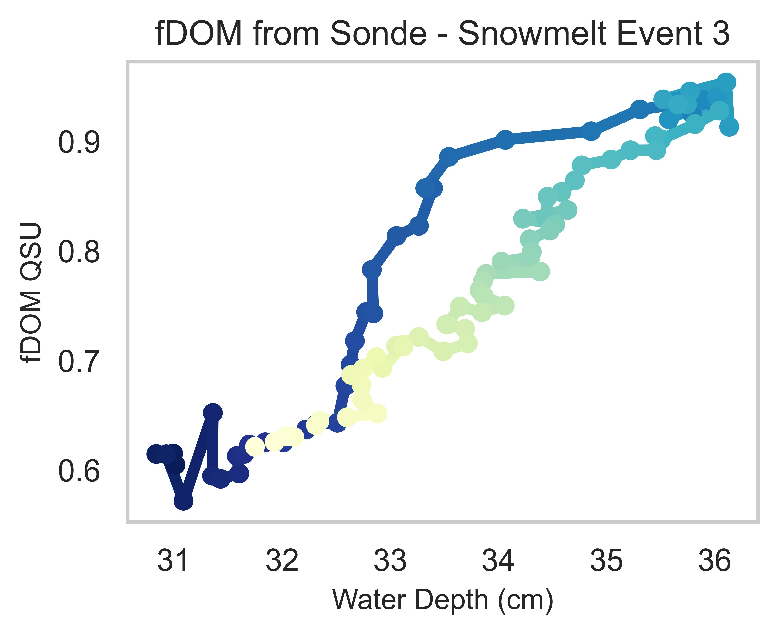
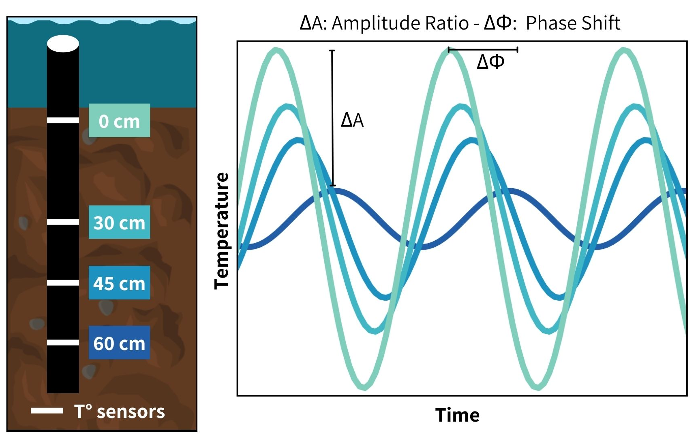
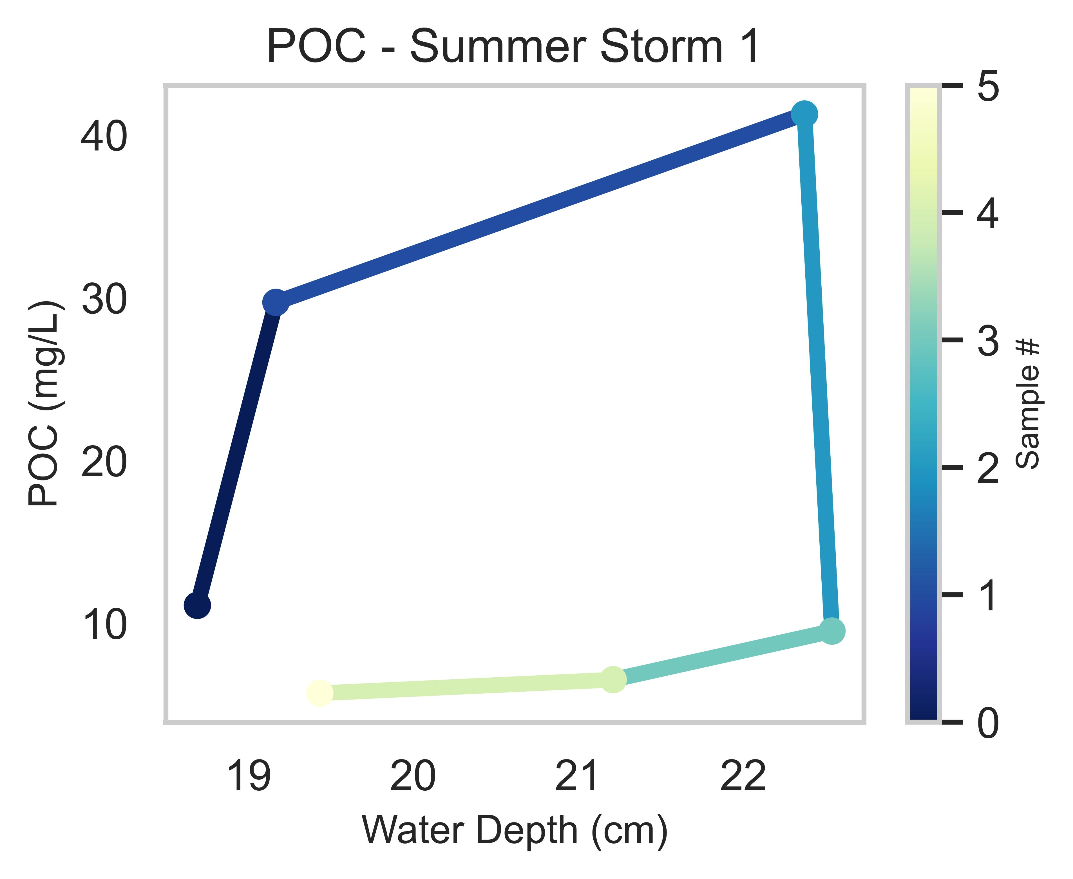
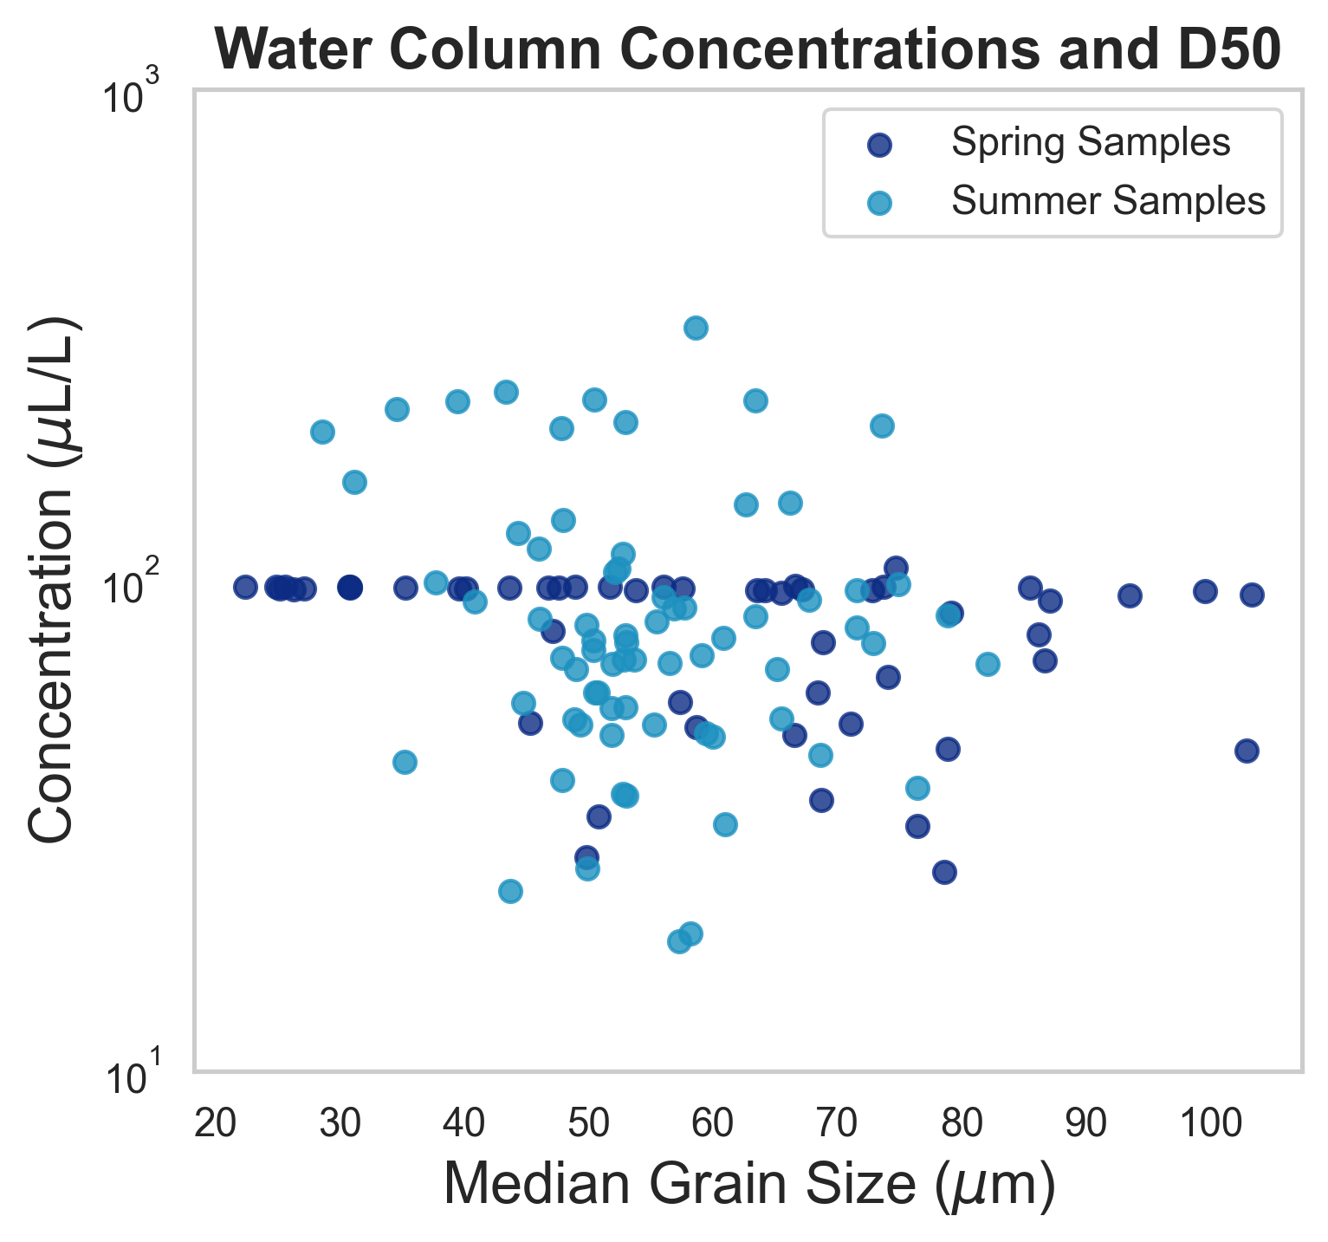

Impacts of streambed dynamics on nutrient and fine sediment transport in mountain rivers
Elowyn Yager^{1*}, Nicole Hucke¹, Rachel Watts², Andrew Tranmer¹, Janice Brahney², Joel Rowland³, George Perkins³ and Rose Harris³
¹University of Idaho, Boise, ID
²Utah State University, Logan, UT
³Los Alamos National Laboratory, Los Alamos, NM
Environmental System Science Program
Summary
Results
Spring and Summer Fine Sediment Deposition
The armor layer protects the finer bed subsurface from erosion, but when dislodged during high flow events it can release fine sediment enriched in Phosphorus (P) and Organic Carbon (OC).
Hysteresis and seasonal variations in particulate and soluble reactive phosphorus (PP and SRP) and in particulate and dissolved organic carbon (POC and DOC) could be controlled by armor layer motion
By monitoring summer monsoon and snowmelt flows and conducting field experiments in a mountain stream in NM, our preliminary results suggest that the quantity of fine sediment in the riverbed is related to local hyporheic flux and flow velocity.
Particulate constituents such as POC and suspended sediment (SS) often show clockwise hysteresis, whereas DOC showed different hysteresis for different seasons, suggesting they are coming from different sources.
We are currently investigating these sources and constraining the exact timing of armor layer motion in each event.
The sediment traps demonstrated that the total captured sediment weight was higher for the spring samples.
Preliminarily, we also found that the spring sediment particle size distribution (PSD) is coarser than the summer sediment PSD
Total deposited sediment weight correlates better with hyporheic flux for the open traps than for the closed traps for both seasons.
Other deposition effects such as horizontal velocity (obtained through ADV measurements) and Turbulence Kinetic Energy (TKE) were used to compute multivariate regressions
Methods
Study Site: La Jara Creek,
Valles Caldera National Preserve, NM
Settling velocities and different grain sizes are yet to be added to this analysis
1. Capturing Hysteresis:
Turbidity and fDOM*
Laboratory Procedures
Preliminary results show that hyporheic flux and horizontal velocity can potentially explain the amount of deposited sediment in open traps. Closed traps showed little to no relation with hyporheic flux, as expected, but was related to the horizontal velocity and TKE.
Regression Variables: |  | Hyporheic Flux, Horizontal Velocity and TKE |  | Hyporheic Flux and Horizontal Velocity |  | Hyporheic Flux and TKE
Type of traps: |  | CLOSED | OPEN | CLOSED | OPEN | CLOSED | OPEN
R² values | R² | 0.413 | 0.791 | 0.375 | 0.677 | 0.310 | 0.791
 | Adjusted R² | 0.192 | 0.702 | 0.236 | 0.597 | 0.156 | 0.739
Coefficients | Hyp. Flux | 19.621 | -6.556 | 9.708 | -67.069 | 28.416 | -5.177
 | Hor. Vel. | 13.139 | 0.693 | 18.505 | 21.704 | - | -
 | TKE | 22.304 | 67.457 | - | - | 47.032 | 69.052
P values | Hyp. Flux | 0.524 | 0.865 | 0.711 | 0.024 | 0.355 | 0.845
 | Hor. Vel. | 0.270 | 0.958 | 0.046 | 0.025 | - | -
 | TKE | 0.493 | 0.092 | - | - | 0.076 | 0.004
Collected using a YSI EXO2 Sonde
SS – Laser diffraction
method (LISST portable XR)
POC – Eurovector elemental analyzer coupled to an Isoprime IRMS
DOC – OI Analytical Aurora 1030 TOC Analyzer
SRP & PP – SpectraMax M2e
Water samples (SS, SRP, PP, DOC & POC)
Stage-triggered portable ISCO samplers
Flow depth and Discharge
Pressure transducers in stilling wells
* Fluorescent dissolved organic matter – a reliable proxy for DOC
2. Fine Sediment Deposition
Sediment traps with open and closed bottoms were installed next to subsurface temperature probes during the spring of 2023
Results
Seasonal Constituent Hysteresis
Downwelling Conditions
Upwelling Conditions
Other deposition effects:
settling velocity
stream turbulence effects
3. Computing Hyporheic Flux
Through diel substrate water temperature fluctuations, we can solve the vertical flux from the 1D advection-diffusion equation using ΔA and ΔΦ.
Temperature-monitoring probes were installed at the locations of each basket group to estimate local hyporheic flux.
POC concentrations in the spring were too low that no reliable hysteresis could be obtained
A total of 7 summer and 4 snowmelt high flow events were captured for hysteresis
Particulate constituents (SS, POC and TP) exhibited clockwise hysteresis in all events for both seasons.
Dissolved constituents (DOC and SRP) differed in their behavior. Hysteresis for SRP changed for different summer storms. Hysteresis for DOC was consistently counter-clockwise in the summer and consistently clockwise in the spring. This suggests that these constituents might come from different sources
Results
Water Column Fine Sediment Concentrations and $D_{50}$
Summer high flow events displayed a wider range of concentrations and higher peak concentrations on average than the spring event concentrations.
Spring high flow events have a wider range of D50’s and a coarser grain size distribution on average compared to the summer samples.
Discussion and Further Work
The different degree of hysteresis and their patterns could be explained by the timing of armor layer motion
Average: | Spring | Summer
Concentration (μL/L) | 80.51 | 95.00
Median Grain Size (μm) | 59.56 | 54.65
For questions, please contact huck4481@vandals.uidaho.edu or eyager@uidaho.edu

